Slide 1
Hiring Process Analytics
(Project – 4)
- BY HITISHA SONI

Slide 2
Project Description :-
Our task is to analyze the company's hiring process data and draw meaningful insights from it.
The hiring process is a crucial function of any company, and understanding trends such as the number of rejections, interviews, job types, and vacancies can provide valuable insights for the hiring department.
As a data analyst, you'll be given a dataset containing records of previous hires.
Your job is to analyze this data and answer certain questions that can help the company improve its hiring process.

Slide 3
Approach :-
In this project, as we are working as a data analyst at a multinational company like Google.
We have given a dataset of a company.
I have used some important concepts of Microsoft excels in this project such as, Pivot table, Pivot Charts, Functions, etc.

Slide 4
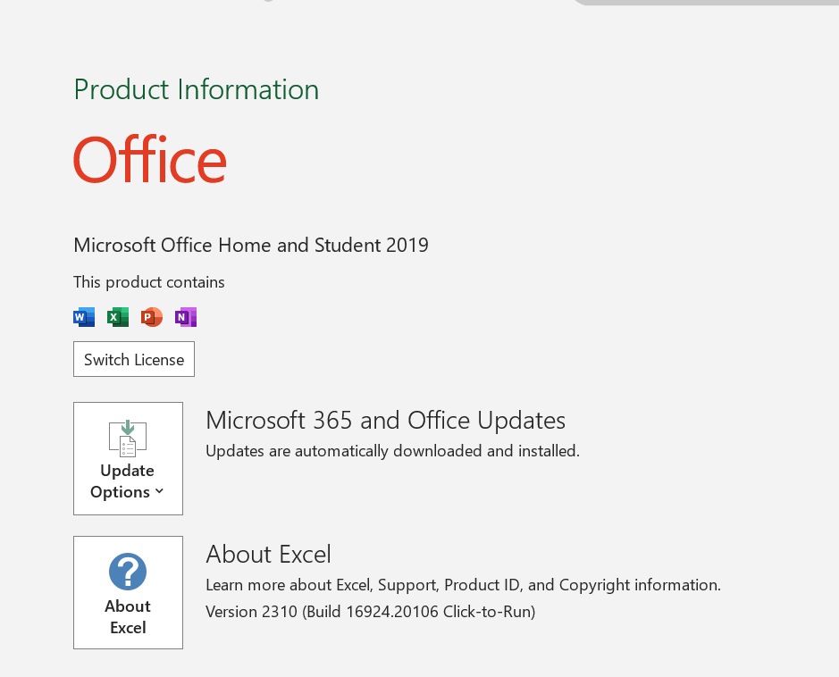
Tech-Stack Used:-

Slide 5
Tasks:
Link to excel file

Slide 6
1. Hiring Analysis: The hiring process involves bringing new individuals into the organization for various roles.
Your Task: Determine the gender distribution of hires. How many males and females have been hired by the company?

Slide 7
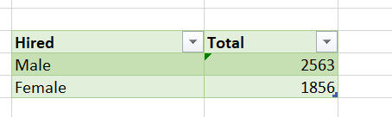

Slide 8
2. Salary Analysis: The average salary is calculated by adding up the salaries of a group of employees and then dividing the total by the number of employees.
Your Task: What is the average salary offered by this company? Use Excel functions to calculate this.

Slide 9
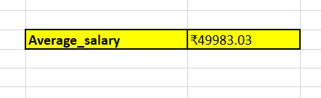

Slide 10
3. Salary Distribution: Class intervals represent ranges of values, in this case, salary ranges. The class interval is the difference between the upper and lower limits of a class.
Your Task: Create class intervals for the salaries in the company. This will help you understand the salary distribution.

Slide 11
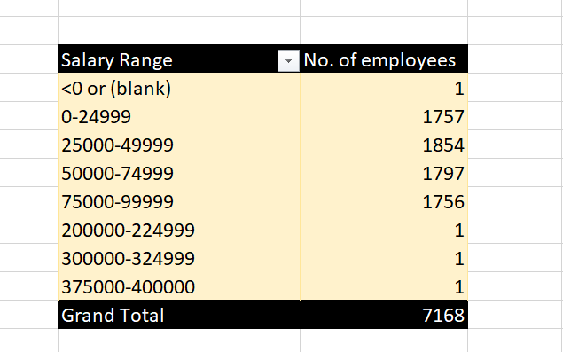

Slide 12
4. Departmental Analysis: Visualizing data through charts and plots is a crucial part of data analysis.
Your Task: Use a pie chart, bar graph, or any other suitable visualization to show the proportion of people working in different departments.

Slide 13
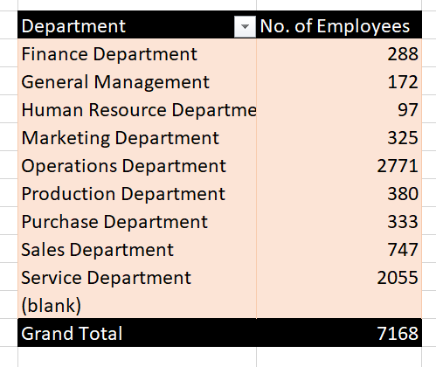

Slide 14
5. Position Tier Analysis: Different positions within a company often have different tiers or levels.
Your Task: Use a chart or graph to represent the different position tiers within the company. This will help you understand the distribution of positions across different tiers.

Slide 15
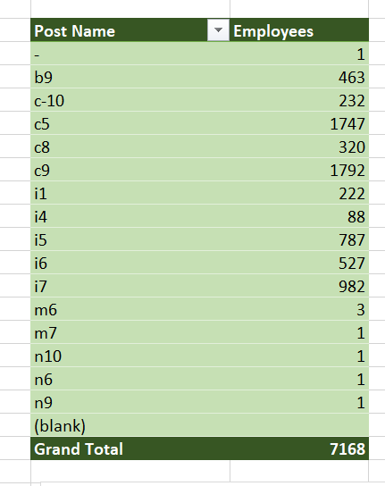

Slide 16
Insights & Results :-
Total no. of hired males are 2563 and females are 1865.
Average salary is ₹49983.03.
Only 3 Employees has salary more than Rs. 2,00,000.
Operations Department have maximum employees.
Human Resource Department have minimum employees.
C9 has most employees.

Slide 17
Thank You

